Slide 1
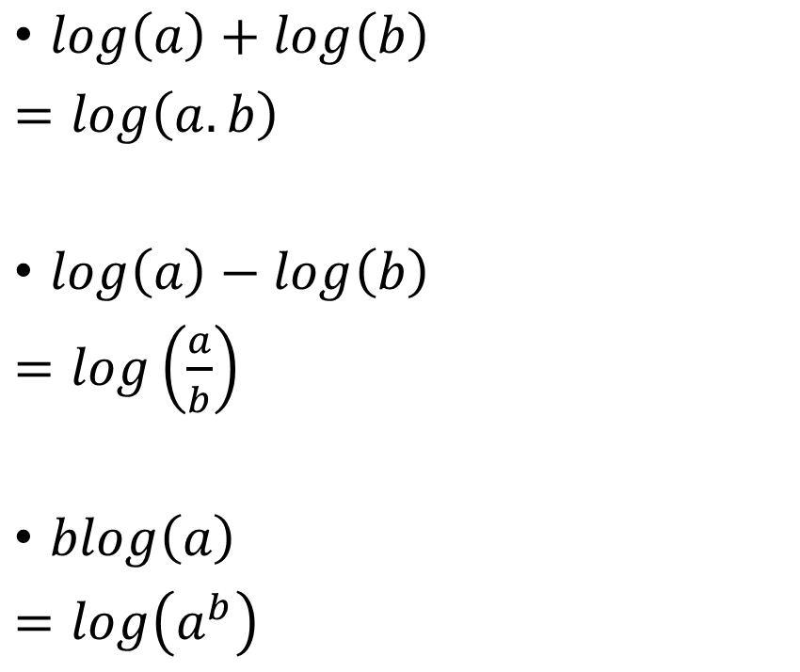
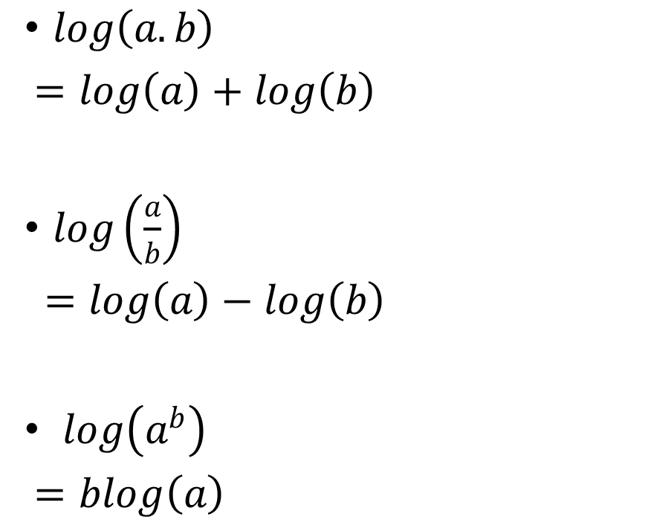
Logarithms
$log\left(a.b\right)$
$=log\left(a\right)+log\left(b\right)$
$log\left(\frac{a}{b}\right)$
$=log\left(a\right)−log\left(b\right)$
$log\left(a^{b}\right)$
$=blog\left(a\right)$
$log\left(a\right)+log\left(b\right)$
$=log\left(a.b\right)$
$log\left(a\right)−log\left(b\right)$
$=log\left(\frac{a}{b}\right)$
$blog\left(a\right)$
$=log\left(a^{b}\right)$

Slide 2
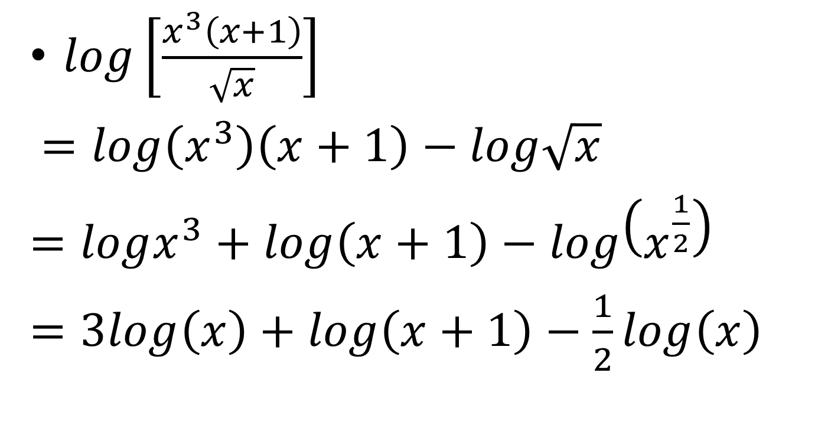
Expanding the Logs
$log\left[\frac{x^{3}\left(x+1\right)}{\sqrt{x}}\right]$
$=log\left(x^{3}\right)\left(x+1\right)−log\sqrt{x}$
$=logx^{3}+log\left(x+1\right)−log\left(x^{\frac{1}{2}}\right)$
$=3log\left(x\right)+log\left(x+1\right)−\frac{1}{2}log\left(x\right)$

Slide 3
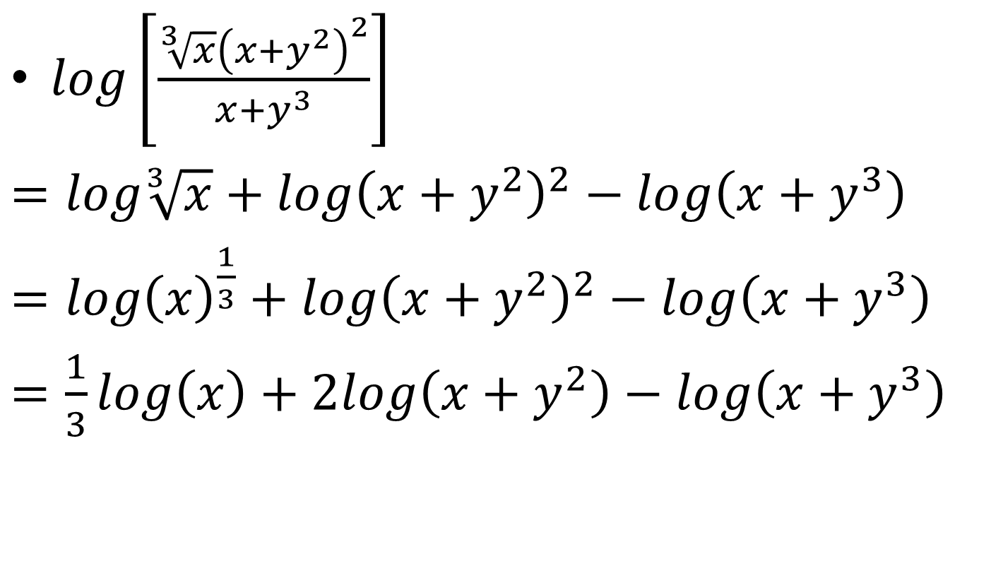
$log\left[\frac{\sqrt[3]{x}{\left(x+y^{2}\right)}^{2}}{x+y^{3}}\right]$
$=log\sqrt[3]{x}+log{\left(x+y^{2}\right)}^{2}−log\left(x+y^{3}\right)$
$=log{\left(x\right)}^{\frac{1}{3}}+log{\left(x+y^{2}\right)}^{2}−log\left(x+y^{3}\right)$
$=\frac{1}{3}log\left(x\right)+2log\left(x+y^{2}\right)−log\left(x+y^{3}\right)$

Slide 4
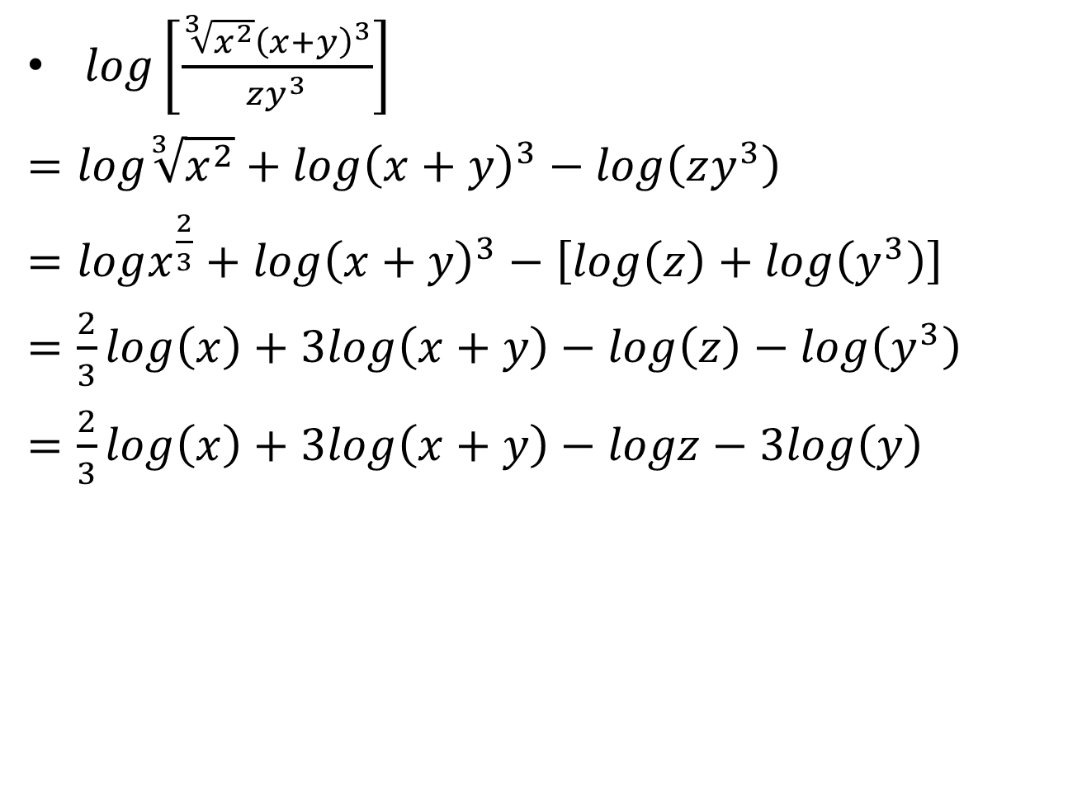
$log\left[\frac{\sqrt[3]{x^{2}}{\left(x+y\right)}^{3}}{zy^{3}}\right]$
$=log\sqrt[3]{x^{2}}+log{\left(x+y\right)}^{3}−log\left(zy^{3}\right)$
$=logx^{\frac{2}{3}}+log{\left(x+y\right)}^{3}−\left[log\left(z\right)+log\left(y^{3}\right)\right]$
$=\frac{2}{3}log\left(x\right)+3log\left(x+y\right)−log\left(z\right)−log\left(y^{3}\right)$
$=\frac{2}{3}log\left(x\right)+3log\left(x+y\right)−logz−3log\left(y\right)$

Slide 5
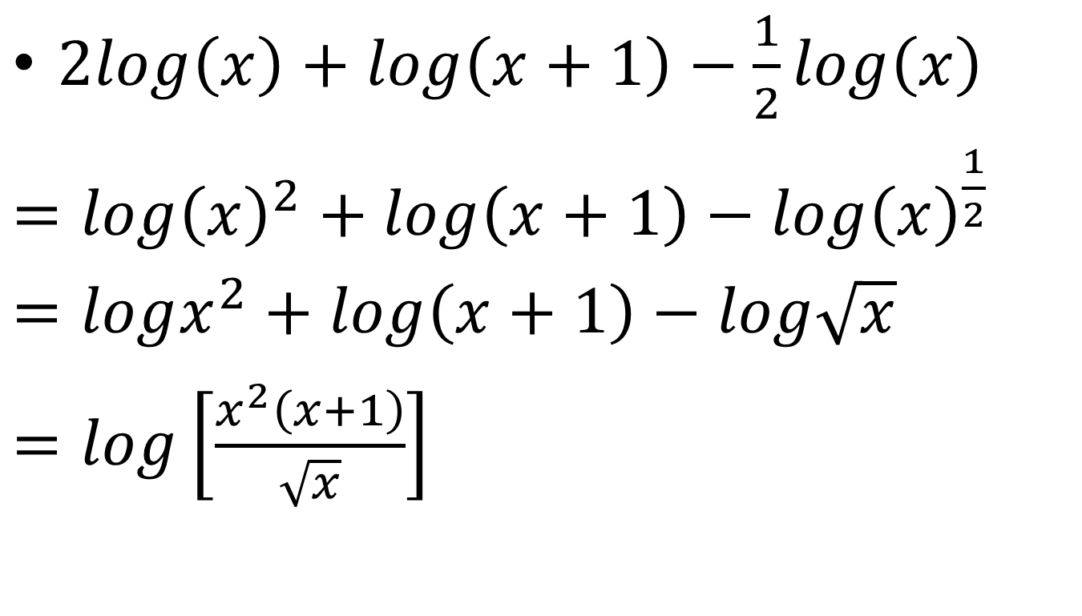
Re writing a term as single log
$2log\left(x\right)+log\left(x+1\right)−\frac{1}{2}log\left(x\right)$
$=log{\left(x\right)}^{2}+log\left(x+1\right)−log{\left(x\right)}^{\frac{1}{2}}$
$=logx^{2}+log\left(x+1\right)−log\sqrt{x}$
$=log\left[\frac{x^{2}\left(x+1\right)}{\sqrt{x}}\right]$

Slide 6
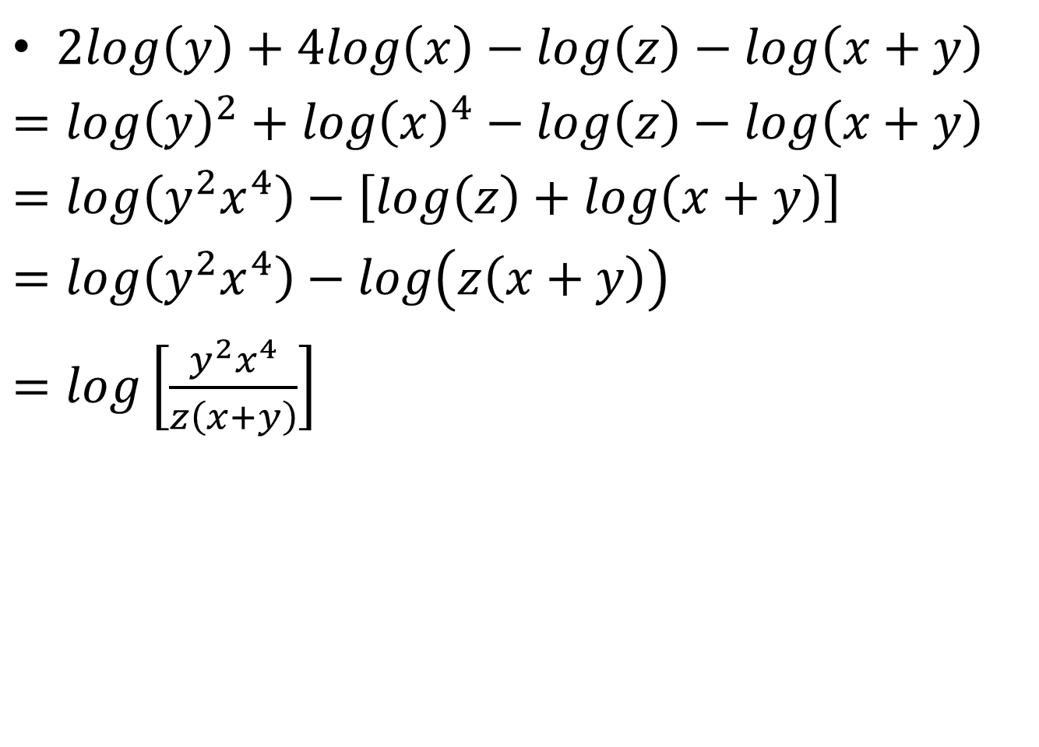
$2log\left(y\right)+4log\left(x\right)−log\left(z\right)−log\left(x+y\right)$
$=log{\left(y\right)}^{2}+log{\left(x\right)}^{4}−log\left(z\right)−log\left(x+y\right)$
$=log\left(y^{2}x^{4}\right)−\left[log\left(z\right)+log\left(x+y\right)\right]$
$=log\left(y^{2}x^{4}\right)−log\left(z\left(x+y\right)\right)$
$=log\left[\frac{y^{2}x^{4}}{z\left(x+y\right)}\right]$

Slide 7
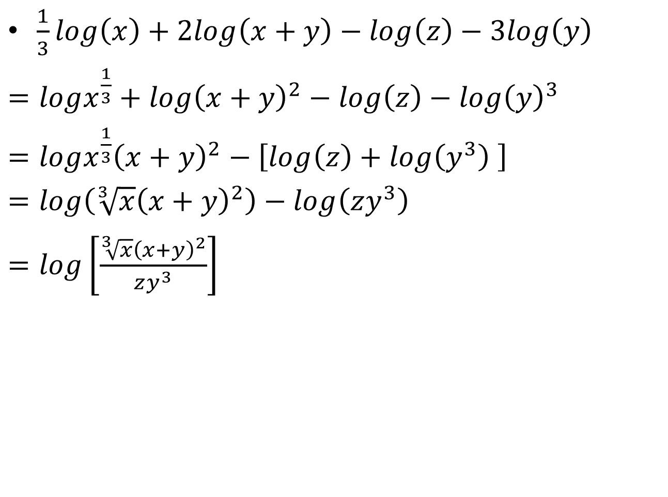
$\frac{1}{3}log\left(x\right)+2log\left(x+y\right)−log\left(z\right)−3log\left(y\right)$
$=logx^{\frac{1}{3}}+log{\left(x+y\right)}^{2}−log\left(z\right)−log{\left(y\right)}^{3}$
$=logx^{\frac{1}{3}}{\left(x+y\right)}^{2}−\left[log\left(z\right)+log\left(y^{3}\right) \right]$
$=log\left(\sqrt[3]{x}{\left(x+y\right)}^{2}\right)−log\left(zy^{3}\right)$
$=log\left[\frac{\sqrt[3]{x}{\left(x+y\right)}^{2}}{zy^{3}}\right]$

Slide 8
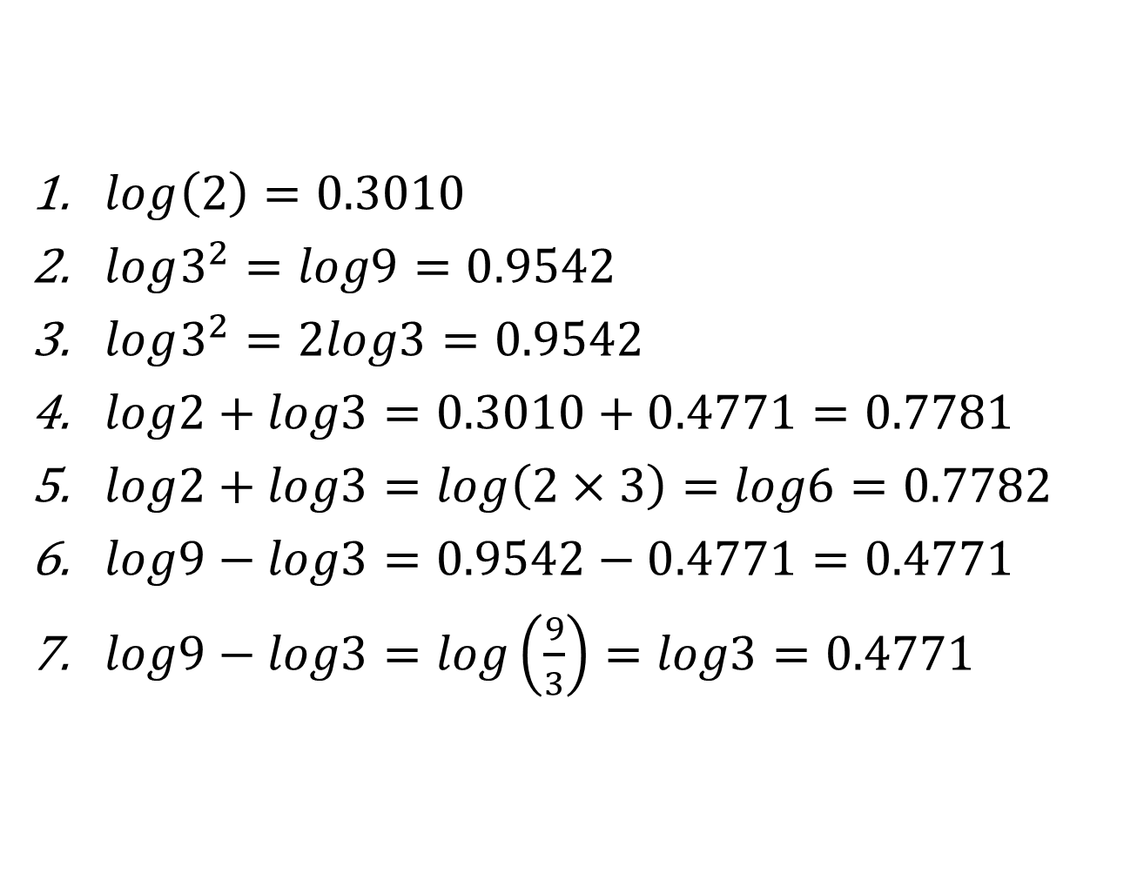
$log\left(2\right)=0.3010$
$log3^{2}=log9=0.9542$
$log3^{2}=2log3=0.9542$
$log2+log3=0.3010+0.4771=0.7781$
$log2+log3=log\left(2×3\right)=log6=0.7782$
$log9−log3=0.9542−0.4771=0.4771$
$log9−log3=log\left(\frac{9}{3}\right)=log3=0.4771$

